Slide 1
Zero to API Testing Hero
Afternoon Session

Slide 2
Afternoon Objectives
Plan and prioritize automation
Setting up the automation project
Automating a GET single item
Automating GET all (deserialization)
Automating POST (serialization)
Automating PUT
Automating DELETE
(If Time) Refactoring
(If Time) Parameterization

Slide 3
Plan and Prioritize Automation

Slide 4
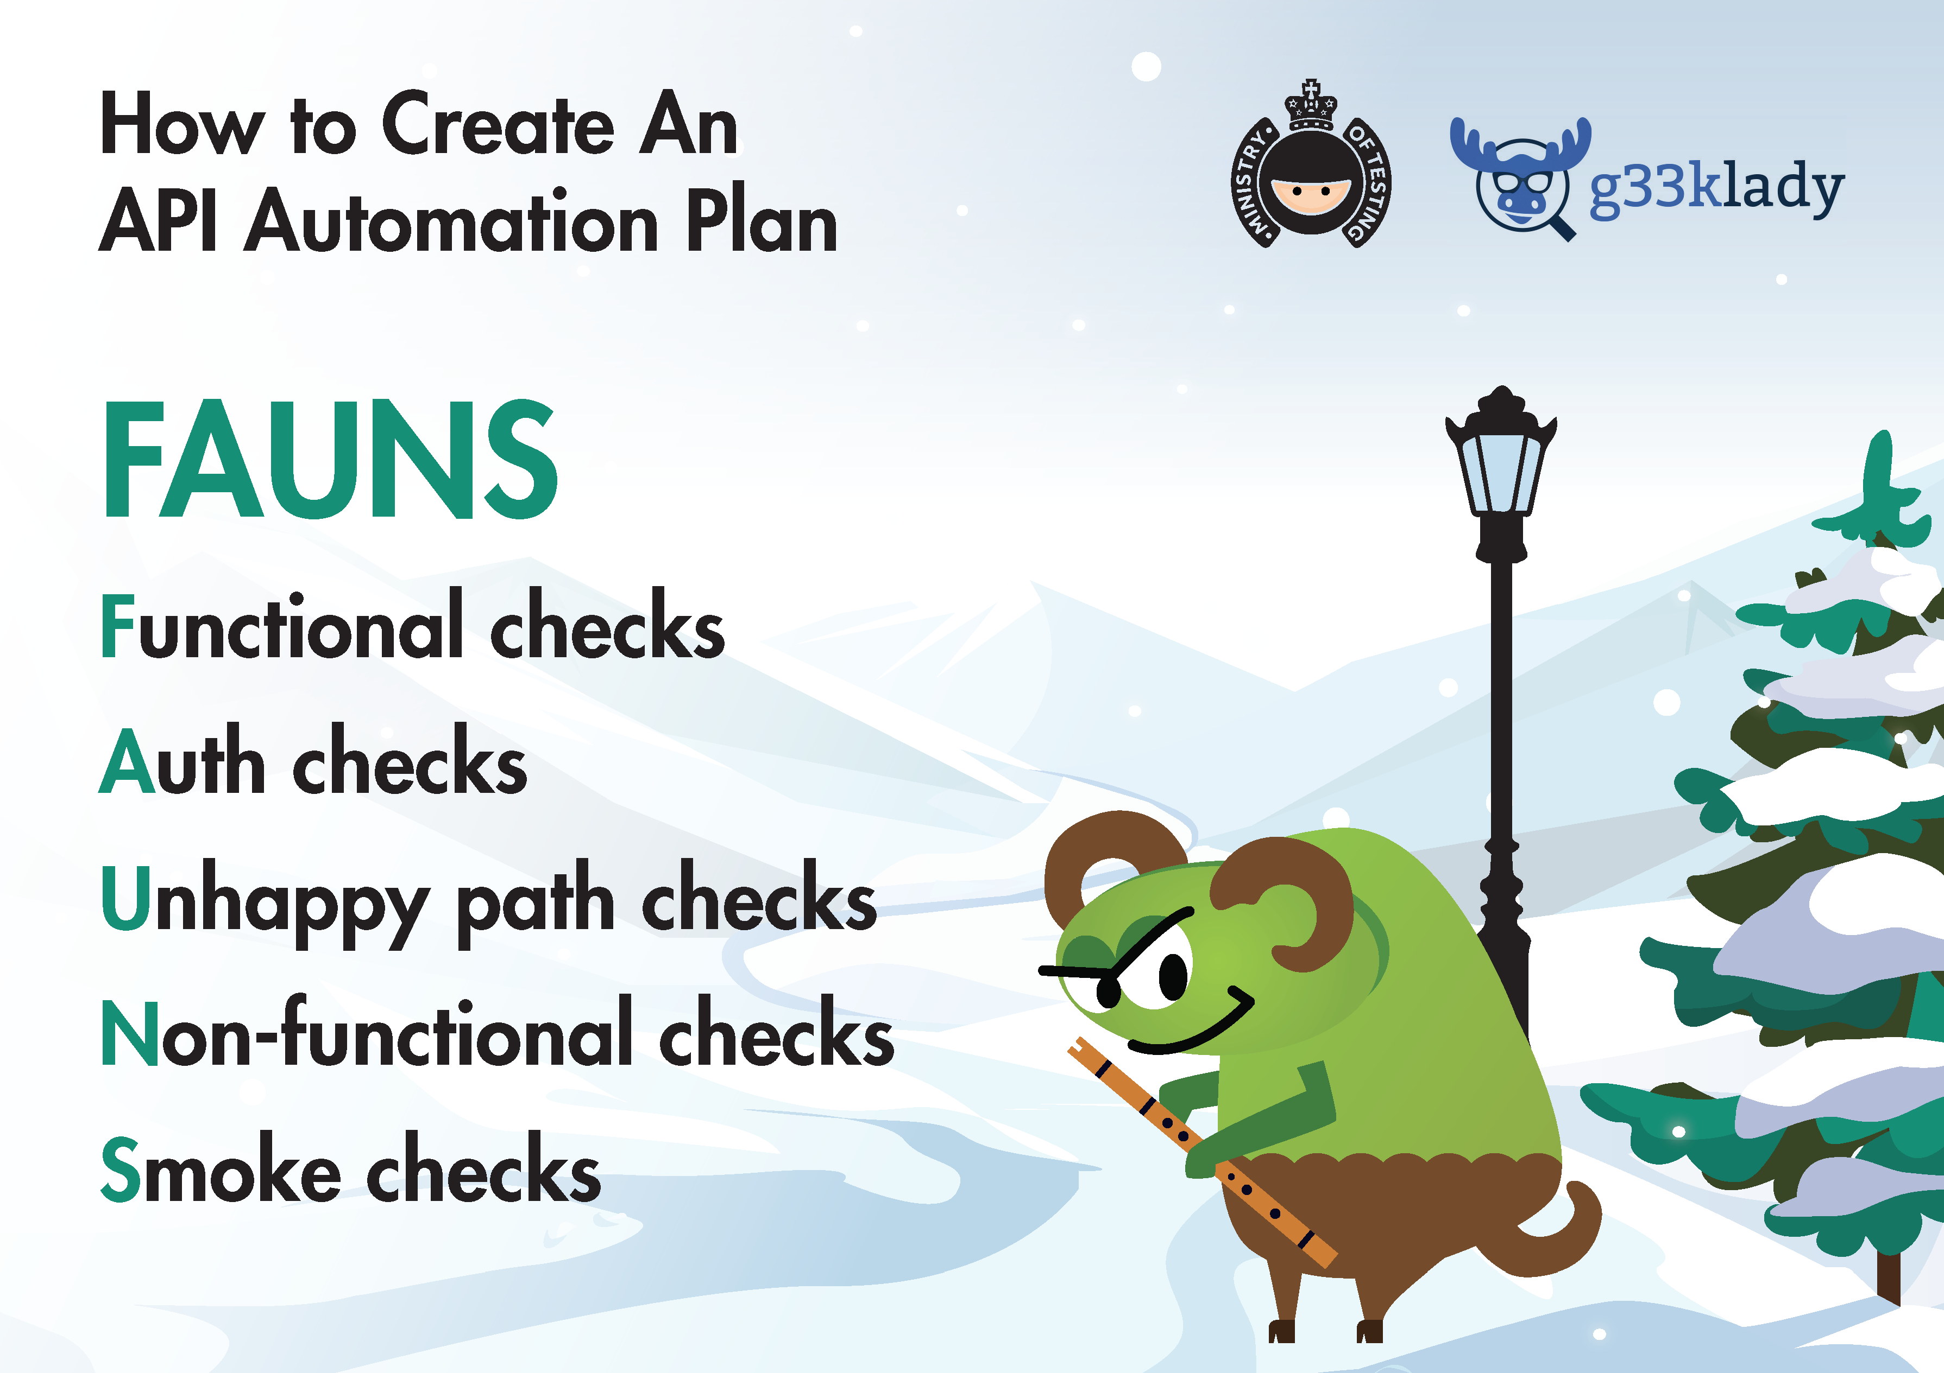

Slide 5
Functional Checks
Each endpoint/method combo w/ happy path input
Sending only required fields
Boundary
Lifecycle of an object to catch issues with concurrency or caching

Slide 6
Auth Checks
Authorization and authentication checks
What roles can access which endpoints and methods
What happens if a token is invalid or missing?

Slide 7
Unhappy Path Checks
Missing required fields
Invalid data/incomplete requests
Intentionally requesting/deleting items that do not exist

Slide 8
Non-Functional Checks
Performance - are the calls meeting our SLA (Service Level Agreement)?
Security (beyond the basic Auth checks) such as XSS and SQL injection
Documentation - especially for an API that is consumed by others, the documentation must be accurate and easy to use
Recovery - how well this recovers after system failure

Slide 9
Smoke Checks
A happy path GET for all endpoints
ONLY GET requests, nothing that alters the environment
Can be run anywhere at any time
Great to do first
Validate your framework/tooling
Add value to the team fast (add to CI/CD, nightly runs, etc.)

Slide 10
Example Automation Plan
Method - Endpoint
Functional
Auth
Unhappy path
Non-functional
Smoke

Slide 11
Example Automation Plan
GET Api/todo
Functional | n/a – covered by Smoke checks
Auth | n/a – no tokens are required
Unhappy path | n/a – no inputs for this endpoint
Non-Functional | Response time should be < 80ms
Smoke | Perform GET -> 200 OK, >1 item returned

Slide 12
Example Automation Plan
GET Api/todo/{id}
Functional | n/a – covered by Smoke checks
Auth | n/a – no tokens are required
Unhappy path | Invalid id -> 404
Non-Functional | Response time should be < 50ms
 | SQL Injection
Smoke | Perform GET w/ valid ID -> 200 OK, 1 item returned

Slide 13
Continue the Automation Plan
POST Api/todo/
Functional | Think of some scenarios here – any from the AM session we could automate?
Auth | POST w/out token -> 401
Unhappy path | Think of some scenarios here – any from the AM session we could automate?
Non-Functional | Response time should be < 50ms
 | SQL Injection
 | Any other scenarios?
Smoke | N/A – not done on POST calls

Slide 14
Continue the Automation Plan
PUT Api/todo/{id}
Functional | Think of some scenarios here – any from the AM session we could automate?
Auth | PUT w/out token -> 401
Unhappy path | Think of some scenarios here – any from the AM session we could automate?
Non-Functional | Response time should be < 50ms
 | SQL Injection
 | Any other scenarios?
Smoke | N/A – not done on PUT calls

Slide 15
Continue the Automation Plan
DELETE Api/todo/{id}
Functional | Think of some scenarios here – any from the AM session we could automate?
Auth | DELETE w/out token -> 401
Unhappy path | Think of some scenarios here – any from the AM session we could automate?
Non-Functional | Response time should be < 50ms
 | SQL Injection
 | Any other scenarios?
Smoke | N/A – not done on DELETE calls

Slide 16
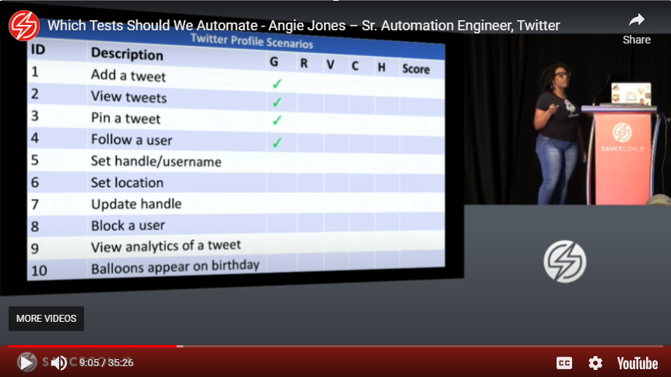

Slide 17
Risk Calculation
Probability
Frequency of use
Impact
If broken, what’s the impact?
Dependencies
What do we depend on, and the risk of things going wrong with them?

Slide 18
Probability
Not just how often but HOW is it being used?
How is the UI using it?
How are other API consumers using it, if any?

Slide 19
Probability
GET all TodoItems
UI
Initial load of the page
After a POST call
After a DELETE call
After a PUT call
Other Consumers
iPhone App mimics UI
Reporting App only makes GET all TodoItems call, 3x day

Slide 20
Impact
If it’s broken or slow, how will it affect
The UI
Other API Consumers

Slide 21


Impact
GET all TodoItems
UI
Other Consumers
iPhone App
Reporting App

Slide 22
Dependencies
What do we depend on?
3rd Party APIs
Infrastructure
What can we mitigate with automation?
Consumer-driven contract tests
Service virtualization and mocking
IAC checks

Slide 23
Ratings
Gut Feeling
Risk = (Probability x Impact) + Dependencies
Value = Distinctness x Induction to Action
Cost Efficiency = Quickness x Ease
History = Similar to weak areas x Frequency of breaks

Slide 24
Prioritizing Automation
Smoke checks are #1
One happy path per endpoint #2
Then prioritize by:
Risk score
then Cost Efficiency score

Slide 25
Prioritizing the Automation Plan
POST Api/todo/ |  | Risk Score (Probability x Impact) | Cost Efficiency | Priority
Functional | POST w/ all valid values -> 201 | 25 | 3 | 2
Auth | POST w/out token -> 401 | 20 | 5
Unhappy path | POST w/ missing Name -> 400 | 12 | 2
 | POST w/ invalid dateDue -> 400 | 12 | 2
Non-Functional | Response time should be < 50ms | 25 | 5 | 3
 | SQL Injection | 25 | 3
Smoke | N/A – not done on POST calls

Slide 26
Our (Simple) Prioritized List
Endpoint | Method | Category | Scenario | Priority Order
/api/Todo | GET | Smoke | Perform GET -> 200 OK, >1 item returned | 1
 | POST | Functional | Perform POST w/ all valid values -> 201 Created and ID returned | 3
/api/Todo/{id} | GET | Smoke | Perform GET w/ valid ID -> 200 OK, 1 item returned w/ same ID | 2
 | PUT | Functional | Perform PUT w/ valid ID and all valid values -> 204 No Content | 4
 | DELETE | Functional | Perform DELETE w/ valid ID -> 204 No Content | 5

Slide 27
Setting Up the Automation Project

Slide 28
Process of Project Setup
Determine where the automation code will live
Create NUnit Project
Install RestSharp NuGet Package

Slide 29
Determine Where the Automation Code Will Live

Slide 30
Sharing a codebase
Pros
Cons
Potential for a very large codebase
Some folks get ‘touchy’
Share utilities and models
Confidence in source control strategy of the team
CI/CD setup less complicated
Less context switching
Team buy-in

Slide 31
Separate codebase
Pros
Cons
Duplicating work
Your own source control strategy
Tooling can be different
Context switching concerns
“Automation code isn’t as important” mentality

Slide 32
Evaluating the pros and cons
We will share the codebase
Whole team on board
Sharing resources in the code
Automation is first class

Slide 33
Create Nunit Project

Slide 34
Load it up!
If you shut down or closed your project, time to load it up again!

Slide 35
Demo/Hands On
Add New Project
NUnit Test Project
Dotnet 6

Slide 36
Install RestSharp NuGet Package

Slide 37
What is RestSharp
REST and HTTP API Client for .NET
Handles requests and responses
Can be used in automation or production code

Slide 38
Working together
Request
Response
Assert
RestSharp
NUnit

Slide 39
Demo/Hands On
Add NuGet Package
RestSharp – Latest version (108)

Slide 40
Automate a Simple GET Request

Slide 41
Demo/Hands On
Rename Class
TestFixture attribute
Using statement
Test method w/ Test attribute
Public async task
AAA
Client
Request
Execute request
Assert
Run Without Debugging
Run tests

Slide 42
Automate a GET All Items Request
Deserialization, too!

Slide 43
What is deserialization?
And why do we care?

Slide 44
Deserialization explained
Taking data from a JSON (or other) response and turning it into an object the code can work with

Slide 45
Json String
C# Object
{
“Id”: 10,
“Name”: “mow lawn”,
“DateDue”: “2018-26-06T00:00:00”,
“IsCompleted”: false
}
TodoItem
Id: 10
Name: mow lawn
DateDue: 6/26/18
IsCompleted: false
string[] response = object.Split(‘,’);
string isCompleted = response[3].Substring(14);
TodoItem.IsCompleted
TodoItem
TodoItem.

Slide 46
Why bother with deserialization?

Slide 47
string[] response = object.Split(‘,’);
string isCompleted = response[3].Substring(14);
string[] response = object.Split(‘,’);
bool isCompleted = Convert.ToBoolean(response[3].Substring(14));
int id = Convert.ToInt64(response[0].Substring(6));
string name = response[1].Substring(9));
DateTime dateDue = Convert.ToDateTime(response[2].Substring(11));
What if the properties are in a different order?
What if a new property is added?
Everything is a string
“false” vs false
Maintenance headache!

Slide 48
Using models in automation code

Slide 49
What is a model?
Objects used for requests and responses in an API
Code uses models to determine
Data structure
Data types expected
Required fields

Slide 50
Demo/Hands On
Review our existing models

Slide 51
Checking values in the response body

Slide 52
Demo/Hands On
GET single item request
Execute w/ deserialization
Assert on a value in the response
Run tests

Slide 53
Refactoring Opportunities
Copy/paste too much! Pull some things out to make adding more tests simple
Pull out API call to a separate method

Slide 54
Automate a POST Request
Serialization, too!

Slide 55
What is serialization?

Slide 56
Serialization explained
Taking an object and transforming it into a JSON string that can be understood by other programs

Slide 57
C# Object
Json String
TodoItem
Id: 10
Name: mow lawn
DateDue: 6/26/18
IsCompleted: false
{
“Id”: 10,
“Name”: “mow lawn”,
“DateDue”: “2018-26-06T00:00:00”,
“IsCompleted”: false
}

Slide 58
Handling HTTP Headers in RestSharp

Slide 59
HTTP Headers Review
Used to pass additional information between client and server
Authentication
Metadata about the data being sent
Message body information

Slide 60
Content-Type Header
API Needs to know what it’s being sent
For JSON data:
Content-type: application/json

Slide 61
Authentication Headers
Provide API with your credentials to “prove” your identity
Basic
NTLM
JWT
Custom

Slide 62
Authentication with the TodoAPI
“Token required”
CanAccess header required
POST
PUT
DELETE

Slide 63
Implementing an HTTP POST request

Slide 64
Demo/Hands On
POST single item request
Create an item
Serialize by adding to request as JsonBody
Set the CanAccess header
Assert on response code
Run tests

Slide 65
Refactoring Opportunities
Pull out API call to a separate method
Make creation of an item for testing it’s own method
Item cleanup?

Slide 66
Automate a PUT Request

Slide 67
A PUT is Like a POST but Different
Send an item like a POST
Need item to already exist (ID)
PUT completely replaces the item

Slide 68
Demo/Hands On
PUT item request
Which item?
Create an item
Serialize by adding to request as JsonBody
Set the CanAccess header
Assert on response code
Run tests

Slide 69
Refactoring Opportunities
Pull out API call to a separate method
Create a new item
Parameterization to make adding more PUT tests easy

Slide 70
Automate a DELETE Request

Slide 71
Need Data Setup
Need item to already exist (ID)
DELETE will completely remove the item so be careful!

Slide 72
Demo/Hands On
DELETE item request
Which item?
Set the CanAccess header
Assert on response code
Run tests

Slide 73
Refactoring Opportunities
Pull out API call to a separate method
Create a new item to delete

Slide 74
Refactoring

Slide 75
Refactoring Opportunities List
SetUp method to remove duplicated code
Pull out API calls to a separate class
Utility method to create a new Todo Item
Separate class for POST so we can have a Teardown to delete the item
Separate class for PUT so we can have a SetUp to create an item, and Teardown to delete it
Separate class for DELETE so we can have a SetUp to create an item

Slide 76
NUnit’s Setup Attributes

Slide 77
Setup Attributes
NUnit has several attributes to set up our checks
SetUpFixture
OneTimeSetUp
SetUp

Slide 78
SetUp vs OneTimeSetUp
SetUp
SetUpMethod
Test1
SetUpMethod
Test2
SetUpMethod
Test3
OneTimeSetUp
OneTimeSetUpMethod
Test1
Test2
Test3

Slide 79
Implement the OneTimeSetUp

Slide 80
Demo/Hands On
Add a OneTimeSetup with baseUrl and client instantiation

Slide 81
Implement the API Calls Class

Slide 82
Demo/Hands On
Create a new class for API call methods
Pull out all of the API calls
Update the API tests

Slide 83
Implement the New Test Item Method

Slide 84
Demo/Hands On
Create a new method to create a todo item
Have defaults
Allow for passing parameters

Slide 85
Implement a New Class for POST Tests

Slide 86
Demo/Hands On
Create a new class for POST tests
Copy POST test over (remove from other file!)
Add a Teardown method to clean up the item

Slide 87
Implement a New Class for PUT Tests

Slide 88
Demo/Hands On
Create a new class for PUT tests
Copy PUT test over (remove from other file!)
Add a SetUp method to create a new item for tests
Add a Teardown method to clean up the items

Slide 89
Implement a New Class for DELETE Tests

Slide 90
Demo/Hands On
Create a new class for DELETE tests
Copy DELETE test over (remove from other file!)
Add a SetUp method to create a new item for tests

Slide 91
Refactoring Opportunities List
SetUp method to remove duplicated code
Pull out API calls to a separate class
Utility method to create a new Todo Item
Separate class for POST so we can have a Teardown to delete the item
Separate class for PUT so we can have a SetUp to create an item, and Teardown to delete it
Separate class for DELETE so we can have a SetUp to create an item
Base class for the common setup across the files

Slide 92
Implement a Base Class

Slide 93
Demo/Hands On
Create a new base class
SetUpFixture
Move SetUp method over
Delete redundant setup code
Add base class declarations

Slide 94
Parameterization and TestCaseData

Slide 95
Parameterization
Passing data as parameters to a check to run the same check with different data each time
Verify input and output values
Saves duplicate code

Slide 96
TestCaseData
NUnit feature for parameterization
Separate class with test data defined
Data is passed to the test method
Test method returns to TestCaseData for assertion

Slide 97
Implement TestCaseData

Slide 98
Demo/Hands On
Create a new class for TestCaseData
Write some inputs and outputs
Update the test to use TestCaseData

Slide 99
Resources

Slide 100
Resources
Slides
Resource links
https://github.com/g33klady/ZeroToApiTestingHero

Slide 101
That’s it!
Questions?

